Slide 1

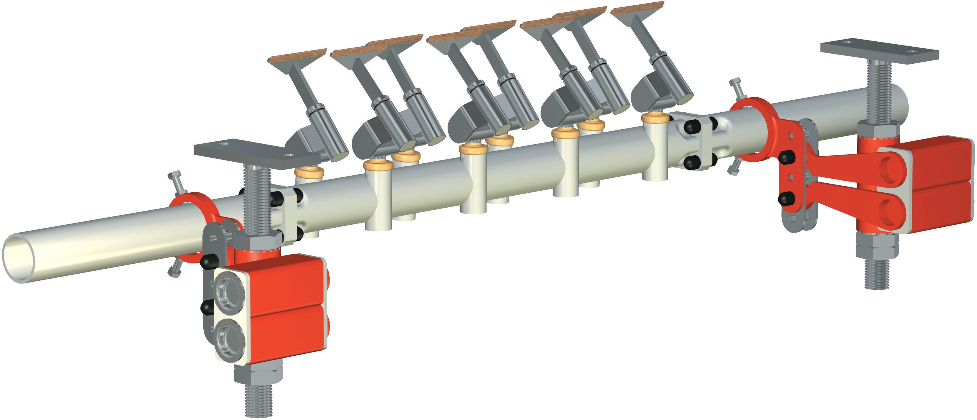
Scraper Type CT - Installation Title
Type CT
Installation Instructions
Installation I - 0490T - 19991104 - EN

Slide 2
Scraper Type CT - Installation 3
Views of Scraper
Installation I - 0500T - 19991106 - EN

Slide 3






Scraper Type CT - Fixing - Detail: Position of Module Housing
5˚
belt direction
Installation I - 0510T - 19991104 - EN

Slide 4

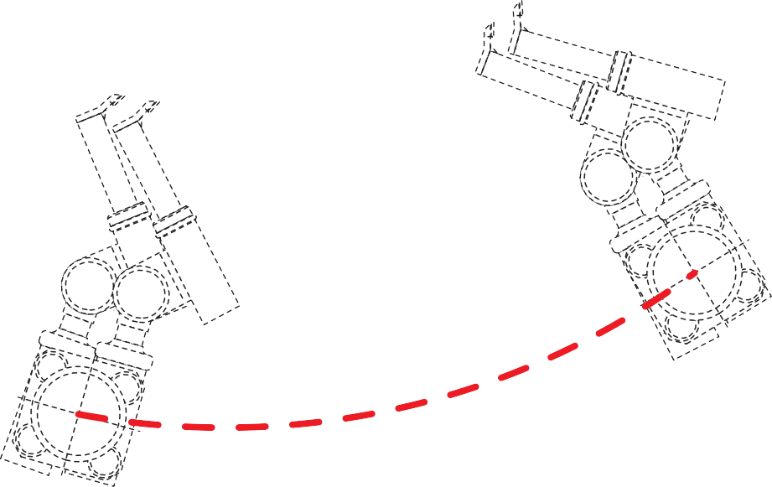




Scraper Type CT - Installation Step 1
Define Scraper Position
1
R
70
A
Installation I - 0520T - 19991122 - EN

Slide 5
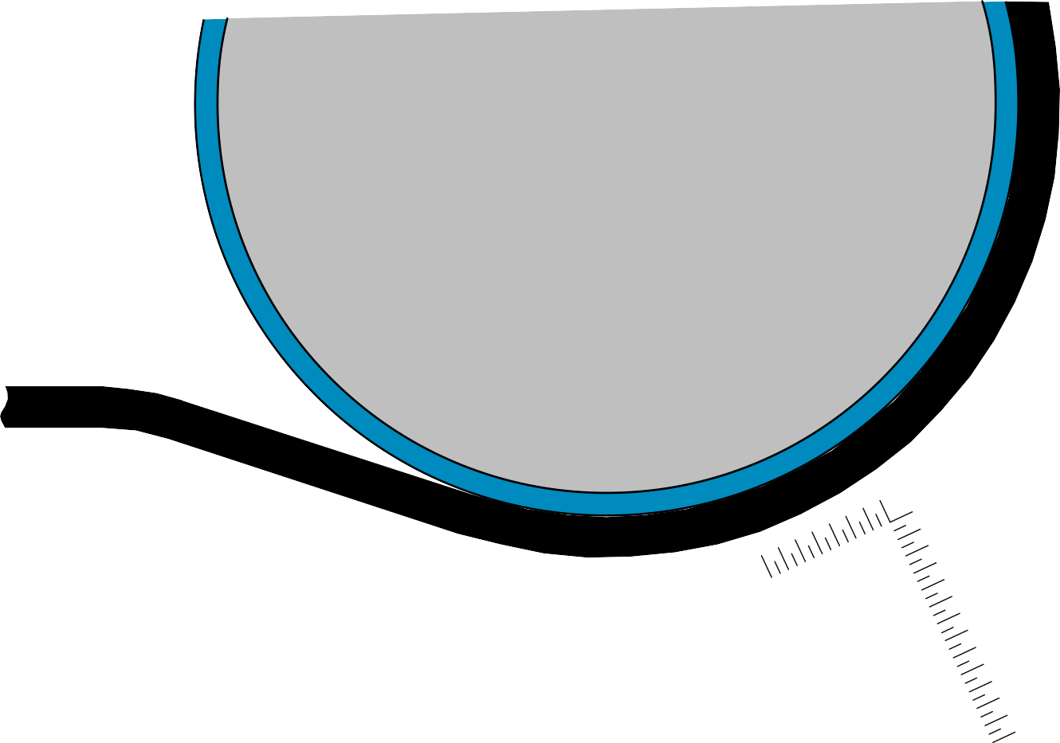




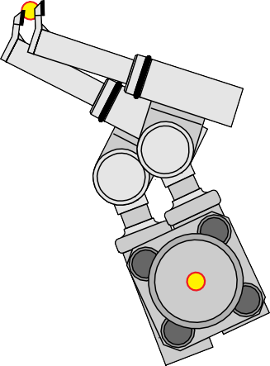
Scraper Type CT - Installation Step 2 Locate center point of midsection
2
15
15
A
B
Installation I - 0530T - 19991122 - EN

Slide 6
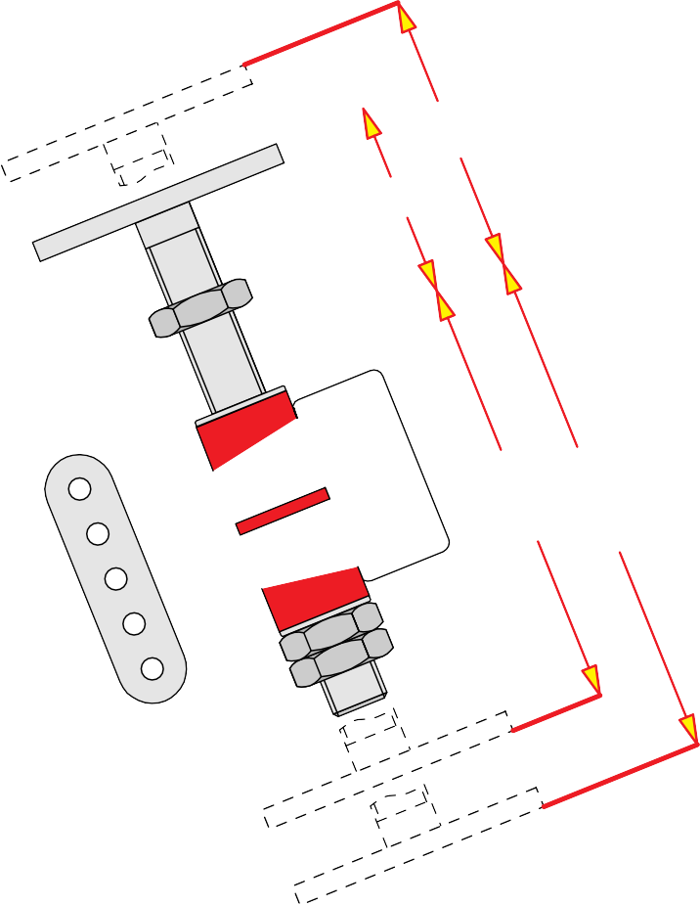


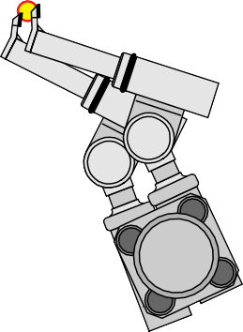
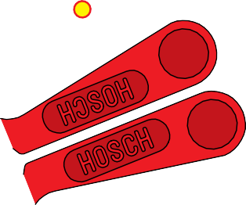
Scraper Type CT - Installation step 3
Select spindle position
3
Dmax
Dmin
Emin
Emax
C
Installation I - 0540T - 19991122 - EN

Slide 7
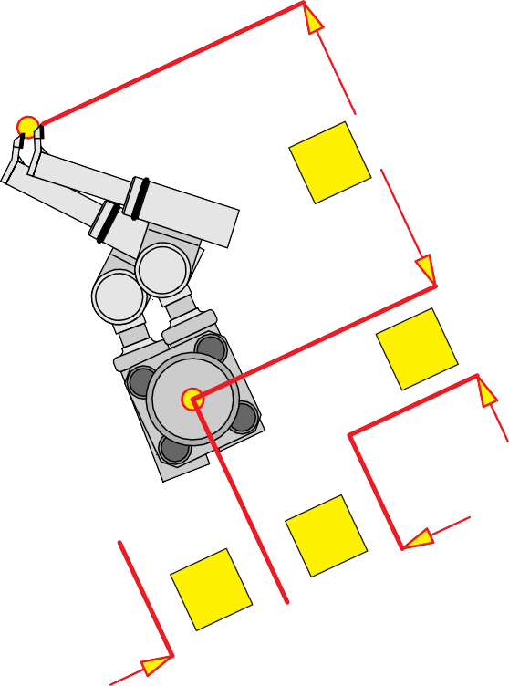


Scraper Type CT - Installation step 4 Provide access for maintenance
4
F
G
I
H
Installation I - 0550T - 19991122 - EN

Slide 8








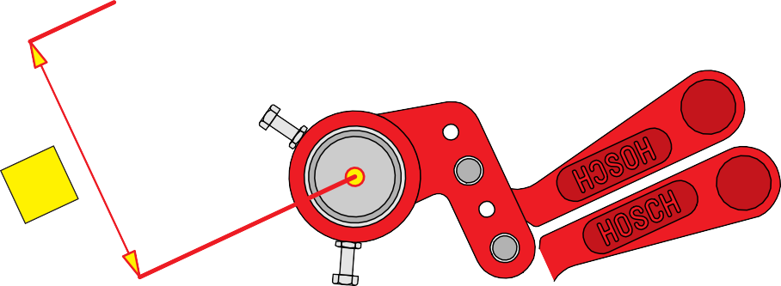

Scraper Type CT - Installation step 5
Install spindles, mounts and locking devices
5
P
A
Installation I - 0560T - 19991122 - EN

Slide 9
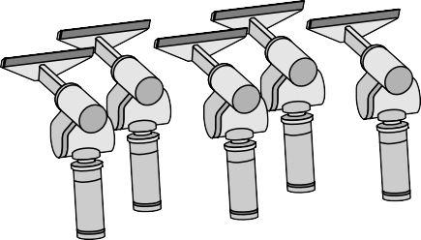
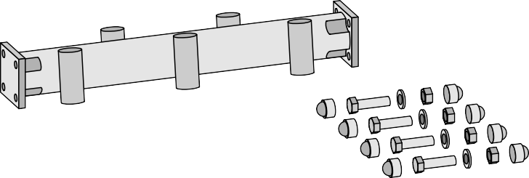
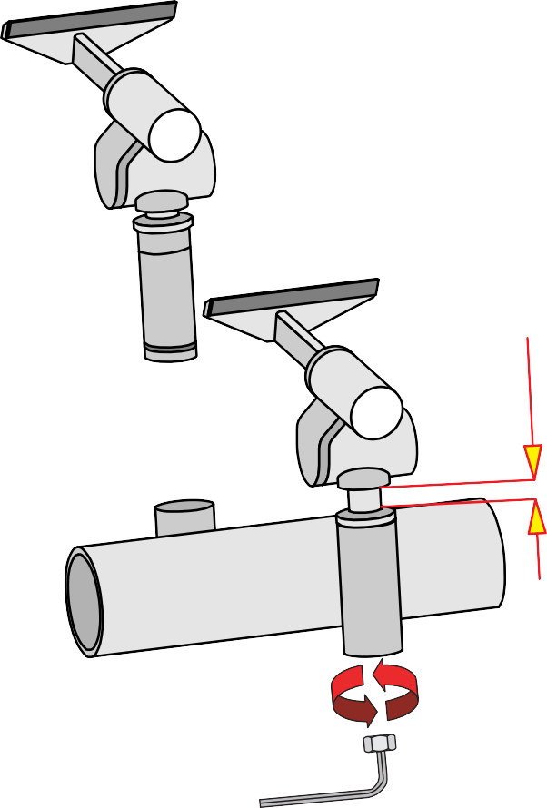
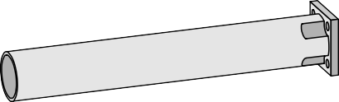
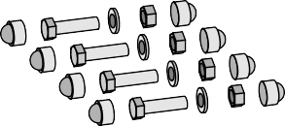
Scraper Type CT - Installation step 6 Prepare scraper for installation
6
1
3
10
2
Installation I - 0570T - 19991122 - EN

Slide 10
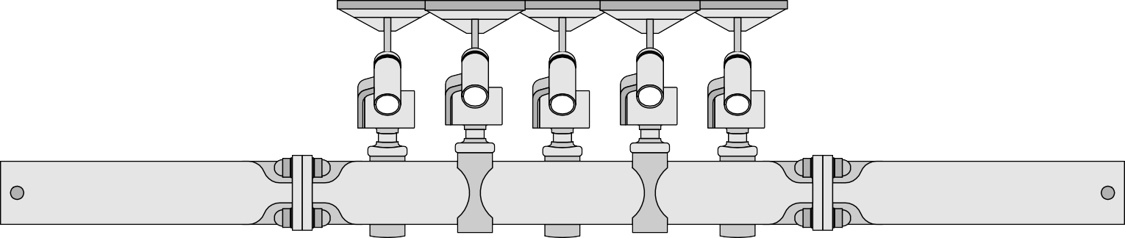





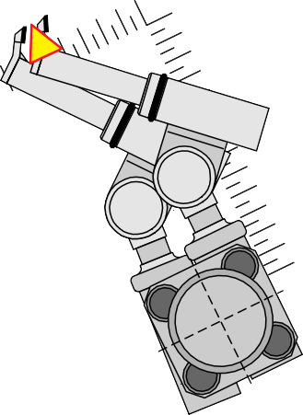





Scraper Type CT - Installation step 7
Align assembly carrier
=
1
=
7
3
=
=
4
2
Installation I - 0580T - 19991122 - EN

Slide 11
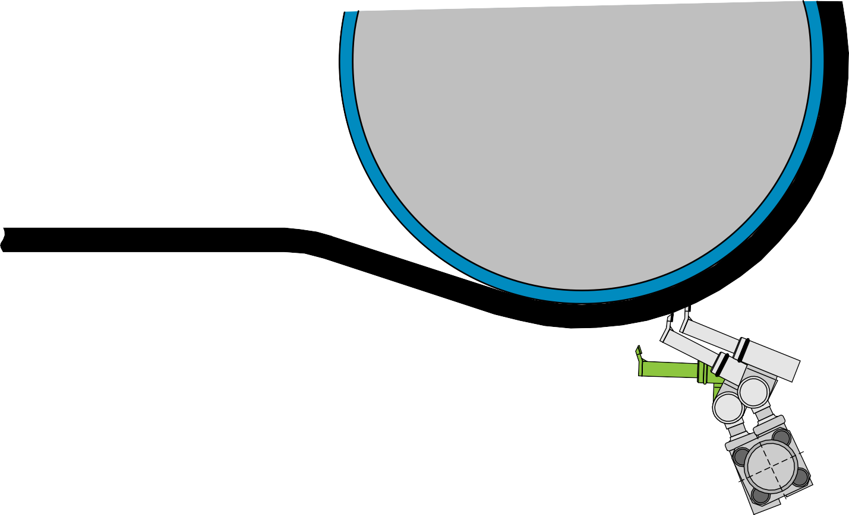




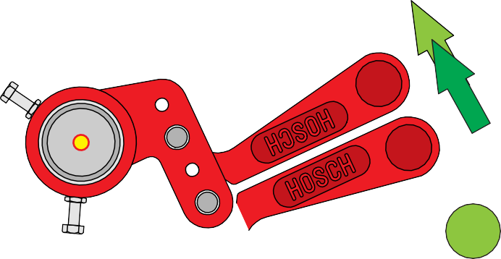



Scraper Type CT - Installation step 8 Pretension scraper
8
1
R
3
2
4
©1999 HOSCH
Installation I - 0590T - 19991122 - EN

Slide 12


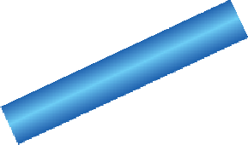

Scraper Type CT - Installation step 9 Check installation
9
1
Installation I - 0600T - 19991104 - EN

Slide 13

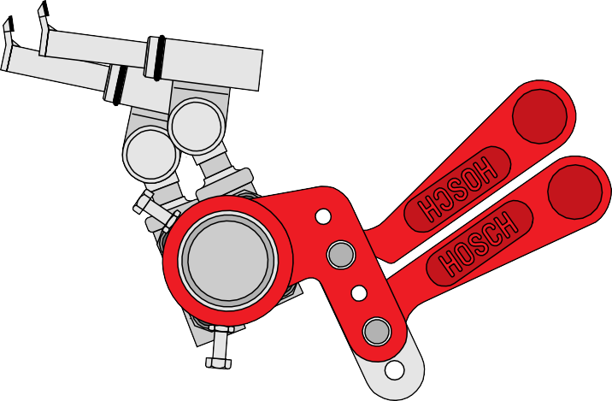

Scraper Type CT - Installation step 10
Perform test run
10
Installation I - 0610T - 19991122 - EN

